Slide 1
Phase Equilibrium Diagrams
Introduction
The understanding of phase diagrams for alloy systems is extremely important
because there is a strong correlation between microstructure and mechanical
properties, and the development of microstructure of an alloy is related to the
characteristics of its phase diagram. In addition, phase diagrams provide valuable
information about melting, casting, crystallization, and other phenomena.
Definitions
Component: chemically recognizable species (Fe and C in carbon steel, H2O and
NaCl in salted water). A binary alloy contains two components, a ternary alloy contains three, etc.
Phase: a portion of a system that has uniform physical and chemical
characteristics. Two distinct phases in a system have distinct physical or chemical
characteristics (e.g. water and ice) and are separated from each other by definite
phase boundaries. A phase may contain one or more components. A single-phase
system is called homogeneous, systems with two or more phases are mixtures or
heterogeneous systems.
Solvent: host or major component in solution,
Solute: minor component.
Solubility Limit: Solubility Limit of a component in a phase is the maximum
amount of the component that can be dissolved in it (e.g. alcohol has unlimited solubility in water, sugar has a limited solubility, oil is insoluble). The same
1

Slide 2
concepts apply to solid phases: Cu and Ni are mutually soluble in any amount
(unlimited solid solubility), while C has a limited solubility in Fe.
For many alloy systems and at some specific temperature, there is a maximum
concentration of solute atoms that may dissolve in the solvent to form a solid
solution; this is called a solubility limit. The addition of solute in excess of this
solubility limit results in the formation of another solid solution or compound that
has a distinctly different composition.
Microstructure: The properties of an alloy depend not only on proportions of the
phases but also on how they are arranged structurally at the microscopic level.
Microstructure is subject to direct microscopic observation using optical or
electron microscopes. In metal alloys, microstructure is characterized by the
number of phases present, their proportions, and the manner in which they are
distributed or arranged. The microstructure of an alloy depends on such variables
as the alloying elements present, their concentrations, and the heat treatment of the
alloy (i.e., the temperature, the heating time at temperature, and the rate of cooling
to room temperature).
Equilibrium and Metastable States
A system is at equilibrium if at constant temperature, pressure and composition
the system is stable, not changing with time.
Equilibrium is the state that is achieved given sufficient time. But the time to
achieve equilibrium may be very long (the kinetics can be slow) that a state along the path to the equilibrium may appear to be stable. This is called a metastable state.
2

Slide 3
It is often the case, especially in solid systems, that a state of equilibrium is never
completely achieved because the rate of approach to equilibrium is extremely slow;
such a system is said to be in a nonequilibrium or metastable state. Often,
metastable structures are of more practical significance than equilibrium ones. For
example, some steel and aluminum alloys rely for their strength on the
development of metastable microstructures during carefully designed heat
treatments. Thus it is important to understand not only equilibrium states and
structures, but also the speed or rate at which they are established and the factors
that affect the rate.
Phase diagram
A phase diagram is a graphical representation of the combinations of temperature,
pressure, composition, or other variables for which specific phases exist at
equilibrium. A phase diagrams show what phases exist at equilibrium and what
phase transformations we can expect when we change one of the parameters of the
system (T, P, composition). We will discuss phase diagrams for binary alloys only
and will assume pressure to be constant at one atmosphere.
Binary Phase Diagrams
A common type of phase diagram is one in which temperature and compositions
are variable parameters and pressure is held constant—normally 1 atm. If more
than two components are present, phase diagrams become extremely complicated
and difficult to represent.
3

Slide 4
An explanation of the principles governing, and the interpretation of, phase
diagrams can be demonstrated using binary alloys even though most alloys contain more than two components.
Binary phase diagrams are maps that represent the relationships between
temperature and the compositions and quantities of phases at equilibrium, which
influence the microstructure of an alloy. Binary phase diagrams are helpful in
predicting phase transformations and the resulting microstructures, which may
have equilibrium or nonequilibrium character.
Binary Isomorphous Systems
In isomorphous system, there is a complete solid solubility of the two components
(both in the liquid and solid phases).
Possibly the easiest example of binary phase diagram to understand and interpret is
the phase diagram of copper–nickel system. Temperature is plotted along the
ordinate, and the abscissa represents the composition of the alloy, in weight
percent (bottom) and atom percent (top) of nickel. The composition ranges from
0 wt% Ni (100 wt% Cu) on the far left horizontal extreme to 100 wt% Ni (0 wt%
Cu) on the right. Three different phase regions, or fields, appear on the diagram, a
solid (α) field, a liquid (L) field, and a two-phase (S- L) field. Each region is
defined by the phase or phases that exist over the range of temperatures and
compositions delineated by the phase boundary lines.
The liquid L is a homogeneous liquid solution composed of both copper and
nickel. The solid (α) phase is a substitutional solid solution consisting of both Cu and Ni atoms and has an FCC crystal structure. At temperatures below about
4

Slide 5
1080°C, copper and nickel are mutually soluble in each other in the solid state for
all compositions. This complete solubility is explained by the fact that both Cu and
Ni have the same crystal structure (FCC), nearly identical atomic radii and electronegativities, and similar valences.
The copper–nickel system is termed isomorphous because of this complete liquid
and solid solubility of the two components.
For metallic alloys, solid solutions are commonly designated by lowercase Greek
letters (α, β, γ, etc.).
With regard to phase boundaries, the line separating the (L) and (α-L) regions is
termed the liquidus line, as indicated in Figure (1-a); the liquid phase is present at
all temperatures and compositions above this line. The solidus line is located
between (α) region and (α-L) region, below which only the solid (α) phase exists.
Practice: Solve the following
A: construct a phase equilibrium diagram for solid solution system contains
metals (X and Y), where:
tow
1- Alloy (100% X) freezes at (400º c).
2- Alloy (100% Y) freezes at (1000º c)
3- Alloy (80% X) starts freezing at (600º c) and ends at (450º c).
4- Alloy (50% X) starts freezing at (800º c) and ends at (500º c).
5- Alloy (30% X) starts freezing at (900º c) and ends at (600º c).
B: In the same system for alloy (40% X) at (600º c) find type, percentage,
composition of phases?
and
C: Sketch cooling curves for alloys 1, 2, 3, 4, and 5.
5

Slide 6
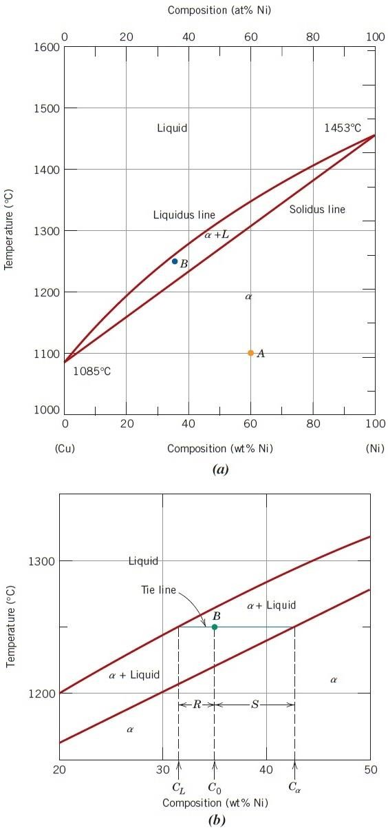

Figure 1
(a) The copper–nickel phase diagram.
(b) A portion of the copper–nickel phase diagram for which compositions and phase amounts are determined at point B.
6

Slide 7
Interpretation of Phase Diagrams
For a binary system of known composition and temperature that is at equilibrium,
at least three kinds of information are available: (1) the phases that are present, (2)
the compositions of these phases, and (3) the percentages or fractions of the phases.
Lever Rule: procedure that is often called the lever rule, which is applied as
follows:
1. The tie line is constructed across the two-phase region at the temperature of the
alloy.
2. The overall alloy composition is located on the tie line.
3. The fraction of one phase is computed by taking the length of tie line from the
overall alloy composition to the phase boundary for the other phase and dividing by the total tie-line length.
4. The fraction of the other phase is determined in the same manner.
5. If phase percentages are desired, each phase fraction is multiplied by 100.When
the composition axis is scaled in weight percent, the phase fractions computed
using the lever rule are mass fractions [the mass (or weight) of a specific phase
divided by the total alloy mass (or weight)]. The mass of each phase is computed
from the product of each phase fraction and the total alloy mass.
7

Slide 8
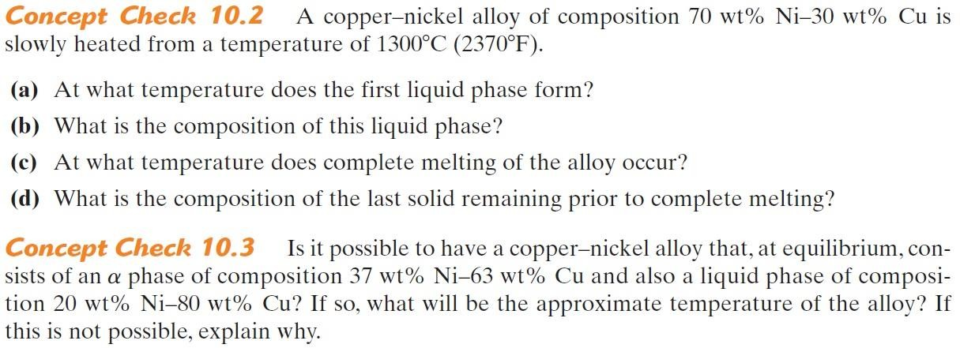
Development of Microstructure in Isomorphous Alloys
A- Equilibrium Cooling
Let us consider the copper–nickel system, an alloy of composition 35wt% Ni –
65wt% Cu as it is cooled from 1300°C. The region of the Cu–Ni phase diagram in
the vicinity of this composition is shown in Figure (2). Cooling of an alloy of this
composition corresponds to moving down the vertical dashed line. At 1300°C,
point a, the alloy is completely liquid (of composition 35 wt% Ni– 65 wt% Cu)
and has the microstructure represented by the circle inset in the figure. As cooling
begins, no microstructural or compositional changes will be realized until we reach
the liquidus line (point b, ~1260°C). At this point, the first solid α begins to form,
which has a composition dictated by the tie line drawn at this temperature [i.e., 46
wt% Ni – 54 wt% Cu, noted as α (46 Ni)]; the composition of liquid is still
approximately 35 wt% Ni–65 wt% Cu [L(35 Ni)], which is different from that of
the solid α. With continued cooling, both compositions and relative amounts of
8

Slide 9
each of the phases will change. The compositions of the liquid and α phases will
follow the liquidus and solidus lines, respectively. Furthermore, the fraction of the
α phase will increase with continued cooling. Note that the overall alloy
composition (35 wt% Ni–65 wt% Cu) remains unchanged during cooling even
though there is a redistribution of copper and nickel between the phases. At
1250°C, point c in Figure 2, the compositions of the liquid and α phases are 32wt%
Ni – 68 wt% Cu [L(32 Ni)] and 43 wt% Ni–57 wt% Cu [α (43 Ni)], respectively.
The solidification process is virtually complete at about 1220°C, point d; the
composition of the solid α is approximately 35 wt% Ni–65 wt% Cu (the overall
alloy composition), whereas that of the last remaining liquid is 24 wt% Ni–76 wt%
Cu. Upon crossing the solidus line, this remaining liquid solidifies; the final
product then is a polycrystalline α -phase solid solution that has a uniform 35 wt%
Ni–65 wt% Cu composition (point e, Figure 2). Subsequent cooling will produce
no microstructural or compositional alterations.
B- Nonequilibrium Cooling
Conditions of equilibrium solidification and the development of microstructures, as
described above, are realized only for extremely slow cooling rates. The reason for
this is that with changes in temperature, there must be readjustments in the
compositions of the liquid and solid phases in accordance with the phase diagram
(i.e., with the liquidus and solidus lines), as discussed. These readjustments are
accomplished by diffusional processes—that is, diffusion in both solid and liquid
phases and also across the solid–liquid interface. Because diffusion is a time-
dependent phenomenon, to maintain equilibrium during cooling, sufficient time
must be allowed at each temperature for the appropriate compositional
9

